Slide 1
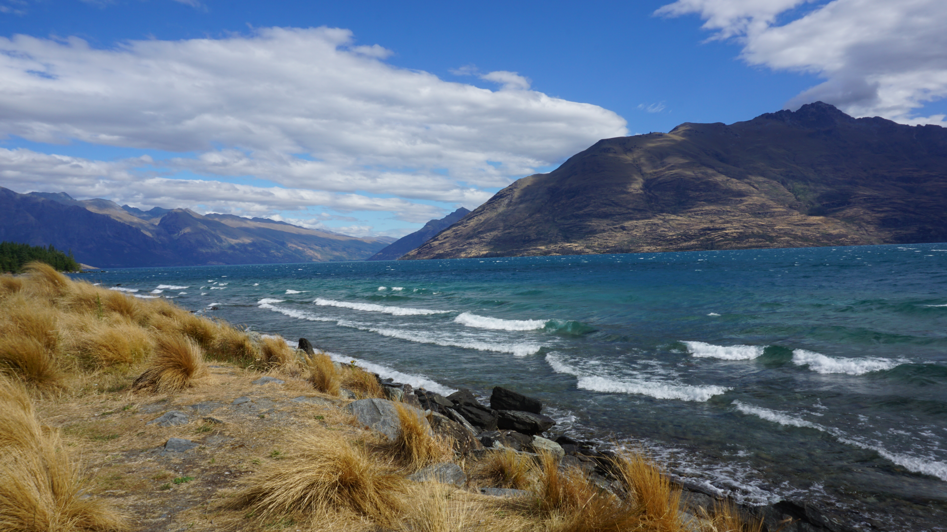
Queenstown, New Zealand

